Slide 1
Yes/No questions with verb Be
Basic 1 – Unit 1 Lesson B

Slide 2
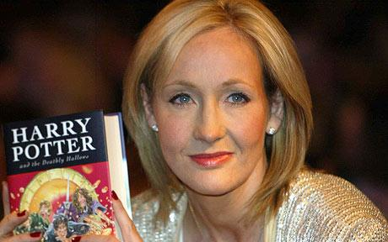
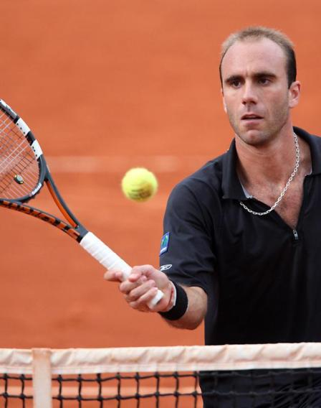
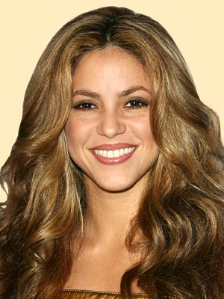
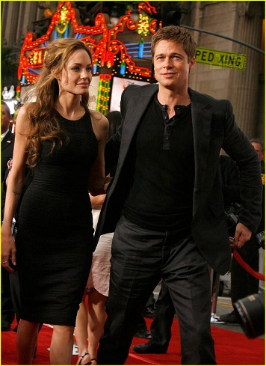
People we like… ☺
Athlete
Writer
Singer
Actress
Actor

Slide 3
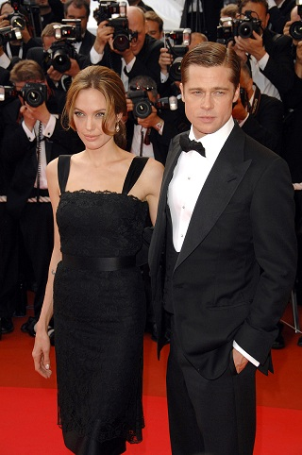
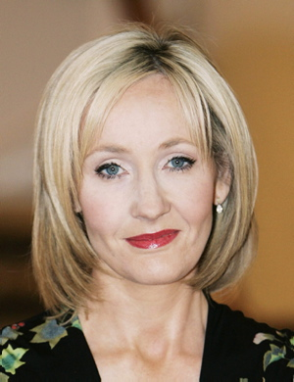
Shakira is a singer.
Luis Horna is an athlete.
J.K. Rowlings is a writer.
Angelina Jolie is an actress.
Brad Pitt is an actor.

Slide 4
Yes/No questions in English
Is
Beyonce
a singer ?
Yes, she is. Beyonce is a singer from the U.S.
Is
Mario Vargas Llosa
an actor?
No, he isn’t. Mario Vargas Llosa is a writer.
Is
your brother
a teacher?
No, he isn’t. My brother is a student.

Slide 5
Yes/No questions in English
Are
you
a student ?
Yes, I am. I am a student.
Is
511
your classroom number?
No, it isn’t. It is 412 .
Is
your favorite singer?
Beyonce
No, she isn’t. My favorite singer is _______.
Yes, she is.

Slide 6
1. ________________________?
Yes, I am. I am Student.
2. ________________________?
No, I am not. I am Juan.
3. ______________________?
Yes it is. His Nickname is Pochi.
4. _____________________?
Yes she is. Alizee a good singer.
5. _______________________?
No, it isn't. It is 123@gmail.com.
6. Are you a writer?
___________________________
7. Is your nickname Pepe?
___________________________
8. Is Shakira your favorite singer?
__________________________
9. Is your brother in Basic 1?
_________________________
10. Are Juan and Pedro popular singers?
_________________________

Slide 7
Communication activity

Slide 8
Ask your partner :
Name
Nickname
Last name
Class
Teacher
Favorite Actor/actress
Favorite Singer
Favorite sports player
Favorite song
Favorite movie
What´s your name?
What´s your nickname
What´s your last name
What´s your class?
Who´s your Teacher?
Who´s your favorite actor/actress
Who´s your favorite Singer
Who´s your favorite sports player?
What´s your favorite song?
What´s your favorite movie?

